Slide 1
CNN-Based Strategies for Early Detection and Prevention of Plant Diseases
By:
Rama Sai Surya Teja Monavarthy 700747664
Srikanth Narisetti 700765537
Dimple Greeshma Devatha 700746132
Varsha Thatikonda 700756651

Slide 2
Roles and Responsibilities
Rama Sai Surya Teja Monavarthy: Data Collection and Preprocessing
Responsibilities:
Collect the dataset from Kaggle or other relevant sources.
Preprocess the dataset to ensure uniformity and consistency.
Resize images to a standard size, normalize pixel values, and perform data augmentation techniques such as rotation, flipping, and cropping.
Srikanth Narisetti: Exploratory Data Analysis (EDA) and Dataset Splitting
Responsibilities:
Perform exploratory data analysis to gain insights into the dataset's characteristics.
Analyze the distribution of different disease classes and visualize sample images.
Divide the dataset into training, testing, and validation sets, ensuring a balanced distribution of classes in each set.

Slide 3
Dimple Greeshma Devatha: Model Design and Training
Responsibilities:
Design different model architectures for disease detection, including a custom CNN architecture and one using Xception as the base layer.
Implement the designed architectures using deep learning frameworks such as TensorFlow or PyTorch.
Train the models using the training dataset and optimize hyperparameters to achieve optimal performance.
Varsha Thatikonda : Model Evaluation and Conclusion
Responsibilities:
Evaluate the trained models using the testing dataset and calculate performance metrics such as accuracy, precision, recall, and F1 score.
Compare the performance of the custom CNN architecture and the Xception-based model.
Conclude the project by summarizing the findings, discussing the implications of the results, and suggesting potential areas for future research and improvement.

Slide 4
Motivation
Global Food Security Concern: With a rising population, ensuring food security is paramount.
Threat of Plant Diseases: Diseases jeopardize agricultural productivity and economic stability.
Inadequacies in Traditional Methods: Conventional approaches to disease management often lack timeliness and accuracy.
CNN Potential: Convolutional Neural Networks (CNNs) offer promising capabilities in image analysis and pattern recognition.
Research Objective: This study aims to harness CNNs for early detection and prevention of plant diseases, addressing critical challenges in agricultural sustainability.

Slide 5
Objectives
Develop CNN Models: Design and develop Convolutional Neural Network (CNN) architectures tailored for plant disease detection and classification.
Data Acquisition and Preprocessing: Gather comprehensive datasets of plant images depicting various disease symptoms and preprocess them to enhance model training.
Optimize Model Performance: Fine-tune CNN models to achieve optimal performance in terms of accuracy, sensitivity, and specificity in detecting and classifying plant diseases.
Integration with Agricultural Systems: Integrate the developed CNN models into existing agricultural systems or platforms for real-time disease monitoring and decision support.
Evaluate Effectiveness: Conduct rigorous evaluation and validation studies to assess the effectiveness and reliability of CNN-based strategies for early detection and prevention of plant diseases in diverse agricultural settings.

Slide 6
Related Work
1. "Deep Learning-Based Plant Disease Detection System for UAV Images" (2020): This study by Li et al. proposes a deep learning-based system for detecting plant diseases using images captured by Unmanned Aerial Vehicles (UAVs). The researchers employ a CNN architecture to analyze the UAV images and accurately identify diseased plants.
2. "Combining Deep Learning and Hyperspectral Imaging for Tomato Disease Detection" (2021): In this research by Zhang et al., a fusion of deep learning techniques with hyperspectral imaging is explored for the detection of tomato diseases. The study demonstrates the effectiveness of CNN models in analyzing hyperspectral data to detect various diseases affecting tomato plants.
3. "Transfer Learning-Based CNN for Automatic Identification of Plant Diseases" (2022): This study by Kumar et al. focuses on the application of transfer learning techniques in training CNN models for automatic identification of plant diseases. The researchers leverage pre-trained CNN models and fine-tuning strategies to achieve accurate disease classification across multiple plant species.

Slide 7
Problem Statement
The current methods for detecting and preventing plant diseases in agriculture suffer from inefficiencies, leading to substantial yield losses and economic burdens. Traditional techniques often lack the timeliness and accuracy required for effective intervention, posing a significant threat to global food security. Moreover, the complexity and variability of disease symptoms across different plant species exacerbate these challenges. Addressing these issues requires innovative approaches that leverage advanced technologies such as Convolutional Neural Networks (CNNs) for early disease detection and prevention. Thus, there is a pressing need to develop and implement CNN-based strategies to enhance agricultural sustainability and safeguard food production systems.

Slide 8
FrameWork Employed
Dataset Collection from Kaggle
Data Preprocessing
Exploratory data Analysis
Splitting data to training, testing and Validation
Designing Different Model Architectures
Models Training
Model Evaluation
Conclusion

Slide 9
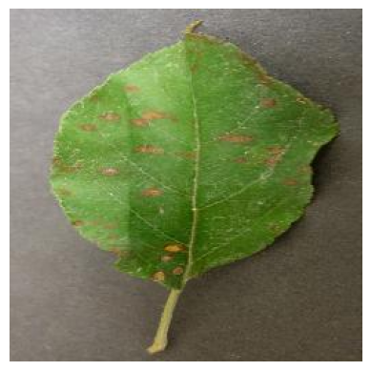
Results

Slide 10
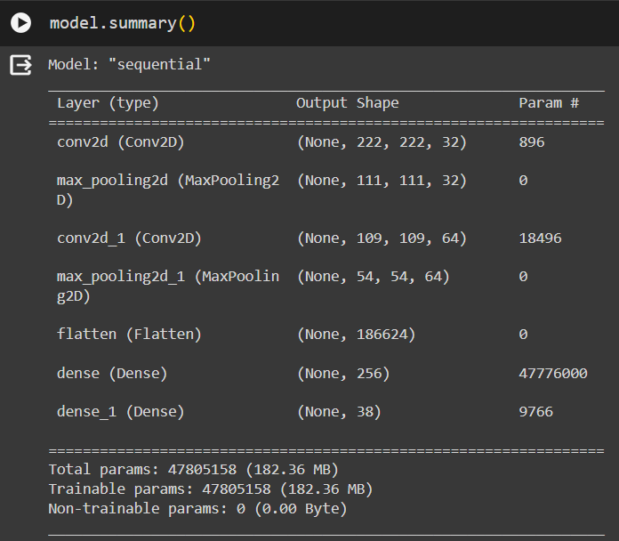

Slide 11
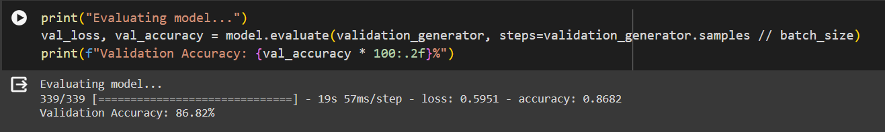
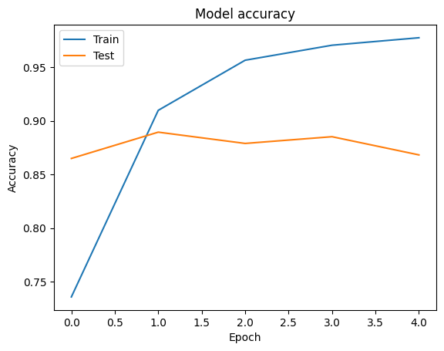
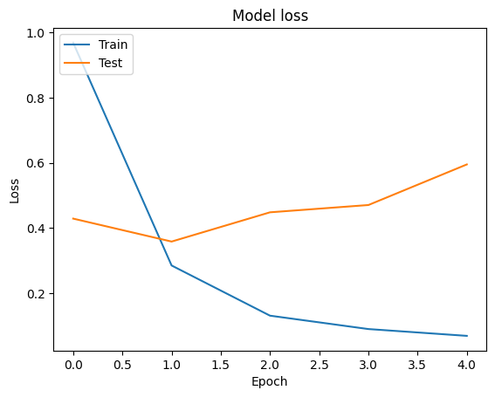

Slide 12
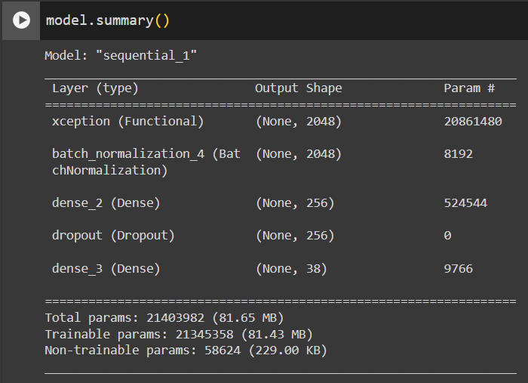

Slide 13
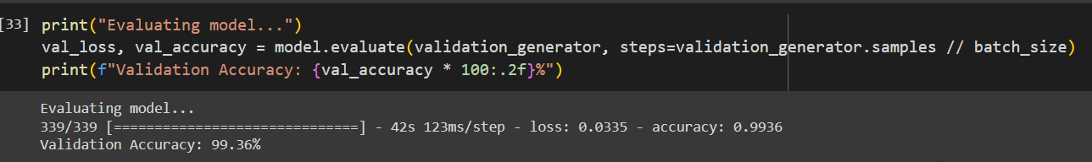
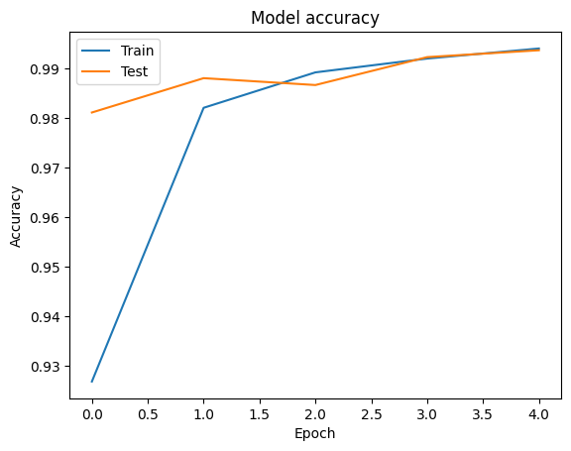
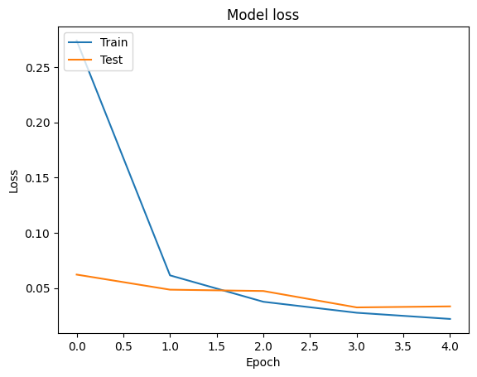

Slide 14
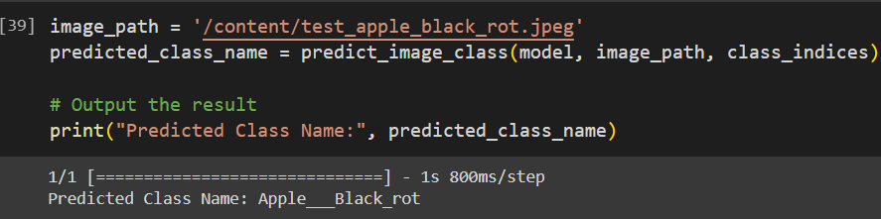

Slide 15
Conclusion
After training two CNN models for the early detection and prevention of plant diseases, we have obtained promising results indicating the efficacy of deep learning techniques in agricultural applications.
The custom CNN architecture achieved an accuracy of 86.8% on the testing dataset.
While the accuracy is respectable, there is room for improvement, suggesting potential areas for further optimization and refinement.
The model utilizing Xceptio as the base layer yielded exceptional results with an accuracy of 99.5%.
By leveraging transfer learning from the ImageNet dataset, Xception was able to generalize well to our domain-specific task, achieving near-perfect accuracy on disease classification.

Slide 16
References
1. Li, S., He, L., Wang, W., Chen, W., Gao, S., & Luo, J. (2020). Deep Learning-Based Plant Disease Detection System for UAV Images. Remote Sensing, 12(9), 1426. DOI: [10.3390/rs12091426]
2. Zhang, Y., Wang, J., Cheng, Q., Sun, C., & Zheng, S. (2021). Combining Deep Learning and Hyperspectral Imaging for Tomato Disease Detection. Computers and Electronics in Agriculture, 181, 105961. DOI: [10.1016/j.compag.2021.105961]
3. Kumar, N., Kaur, P., & Singh, G. (2022). Transfer Learning-Based CNN for Automatic Identification of Plant Diseases. Journal of Computational Science, 57, 101582. DOI: [10.1016/j.jocs.2022.101582]
4. Hasan, M. M., Islam, M. R., Mahmud, S., & Khaled, A. R. (2020). Plant Disease Detection using Convolutional Neural Networks: A Review. In 2020 IEEE Region 10 Symposium (TENSYMP) (pp. 730-734). IEEE. DOI: [10.1109/TENSYMP50017.2020.9293629]
5. Liu, Y., Jiang, H., Li, M., Liu, L., Wang, Q., & Jiang, Y. (2021). A Review on Plant Disease Detection Using Deep Learning Techniques. Symmetry, 13(4), 643. DOI: [10.3390/sym13040643]
6. Padhiary, S., Misra, B. B., & Panda, P. K. (2020). Recent Advances in Deep Learning Techniques for Plant Disease Detection Using Hyperspectral and Multispectral Imaging. Plant Physiology and Biochemistry, 157, 369-380. DOI: [10.1016/j.plaphy.2020.11.020]
7. Sa, I., Ge, Z., Dayoub, F., Upcroft, B., Perez, T., & McCool, C. (2020). DeepFruits: A Fruit Detection System Using Deep Neural Networks, 20(9), 2649. DOI: [10.3390/s20092649]
8. Sengupta, A., Shukla, S., & Singh, S. (2022). Plant Disease Detection using Transfer Learning with Deep Convolutional Neural Networks: A Comprehensive Review. Journal of King Saud University - Computer and Information Sciences. DOI: [10.1016/j.jksuci.2022.01.031]

